Slide 1
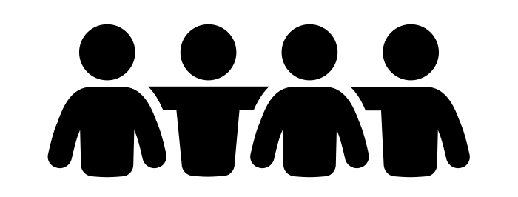
PROJECT PAG-APIL
verb. participate, take part in
Democratizing Data in the Bangsamoro Region
Prince Javier Jeremias Paul
Marc Reyes

Slide 2
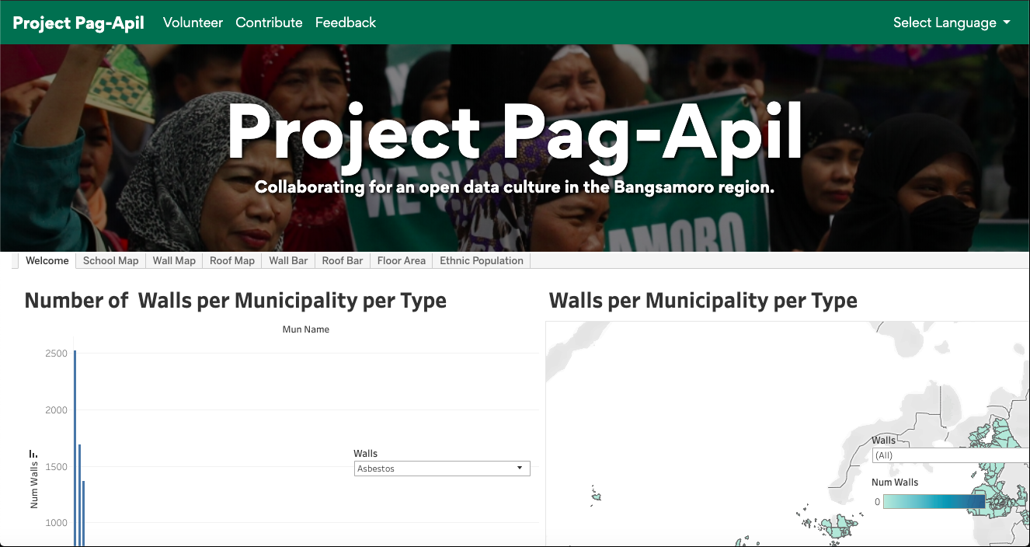

Slide 3
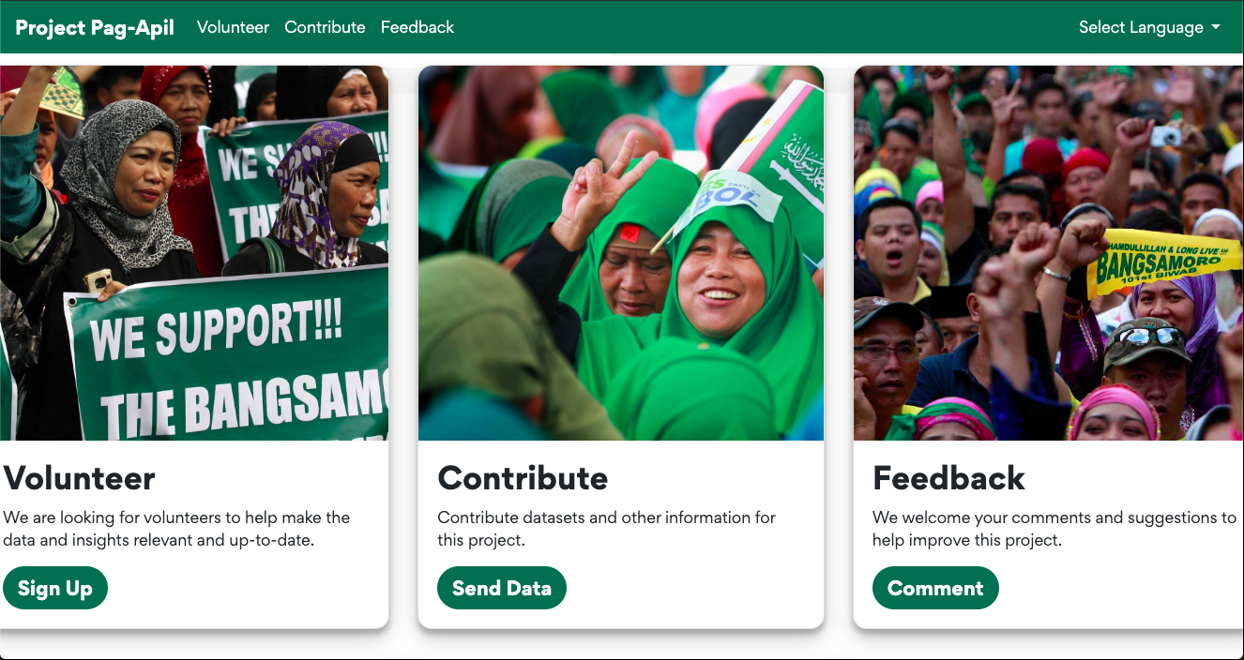

Slide 4
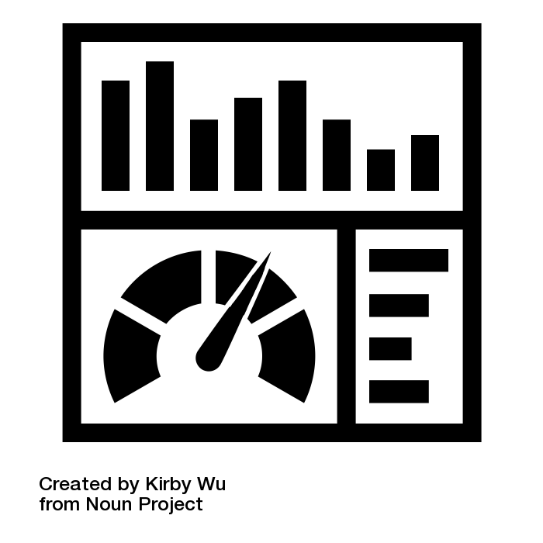
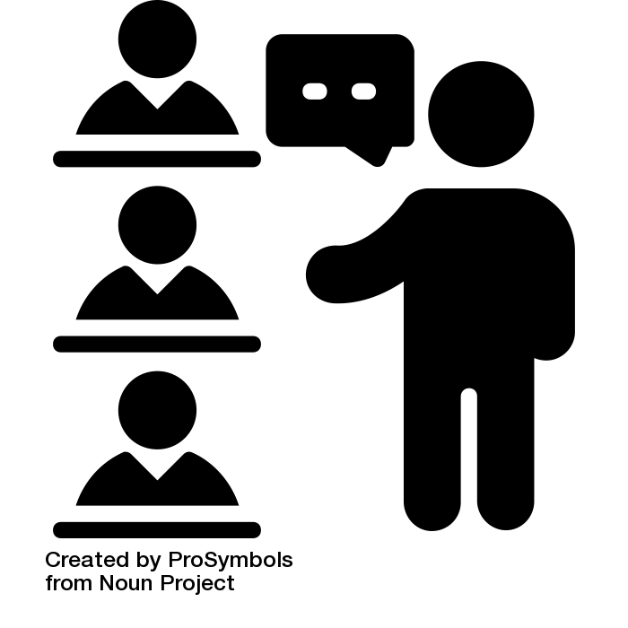

The Problem
1. There is a lack of an openly-available, easily-accessible, and usable repository of baseline information in the Bangsamoro region.
2. Existing data is sparse, unconnected, and has not been updated to reflect the lived experience of the Bangsamoro people.
3. There is a lack of participation from stakeholders at the grassroots level to building an open data culture, which is necessary in this period of transition.

Slide 5

Project Pag-Apil is comprehensive, transparent, inclusive, and participatory
We envision Project Pag-Apil to source data from national institutions and local governments. However, it is also open to all that wish to contribute to creating an open data culture in the Bangsamoro Region. This way, we are able to promote transparency at all level and encourage a more involved citizenry,

Slide 6
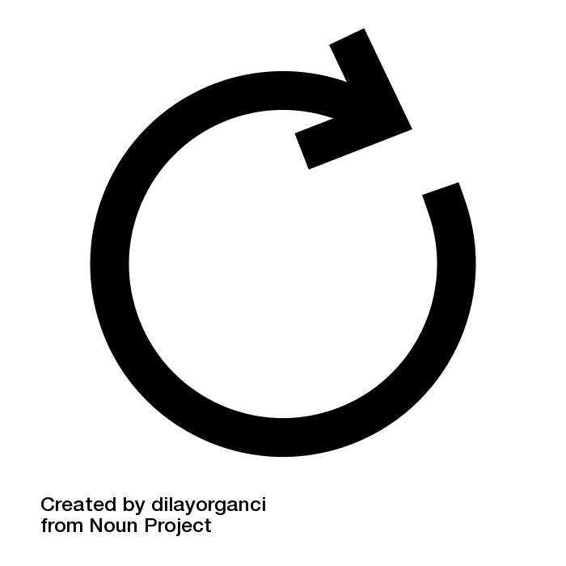
Project Pag-Apil is comprehensive, transparent, inclusive, and participatory
Database
Users can contribute data, suggest improvements, and directly volunteer in a continuous improvement feedback loop
Web App
Volunteer Group
Feedback Loop
Users
Join
Government Agencies
People
NGOs
Private Organizations

Slide 7
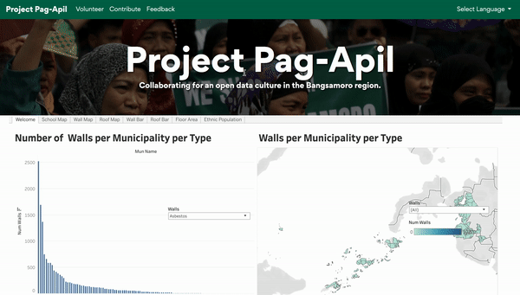
Key Point 1: Project Pag-Apil visualizes data in a simple, easily digestible way

Slide 8

Key Point 2: Project Pag-Apil considers the lived experiences of the Bangsamoro people
We aim to present the data in the most culturally sensitive way:
Currently available in English and Cebuano, and with the capability to add more languages in the future
Using coordinates rather than fixed borders so as to be as neutral as possible for all parties
User submitted data adds specific nuance to the vast amount of data available:
Some data points can be enriched with specific nuances that can only be obtained via user submissions
For example: if there are alternative names to locations only known by the locals

Slide 9
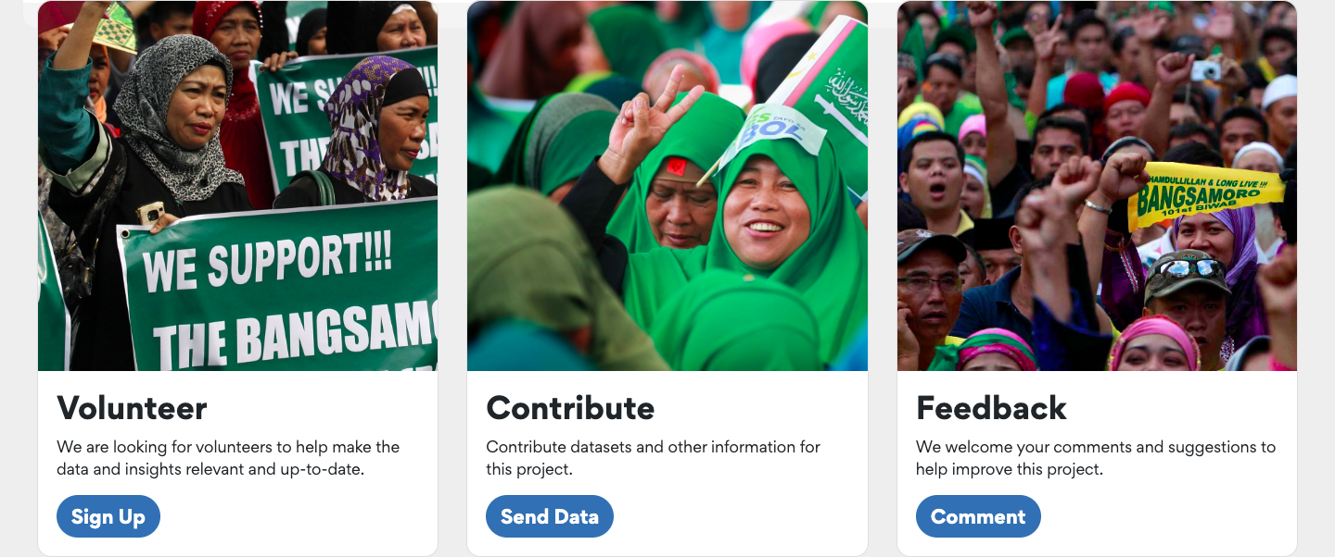
Key Point 3: Project Pag-Apil is inherently participatory; involving stakeholders in all levels, from the grassroots all the way to the local and national levels
We envision this project to be wholly collaborative from the national and local levels. Government agencies, local government units, private corporations, NGOs, and civil society are all involved in the gathering, collating, and organizing the data. Our platform makes this possible.

Slide 10
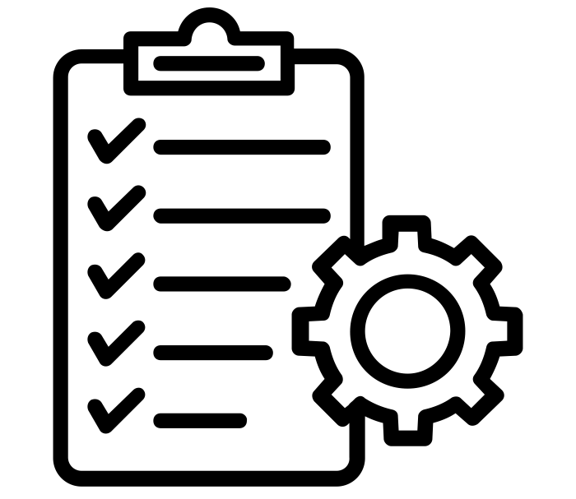
Potential Applications
Planning where to put schools based on which populations lack schools
Planning on policies based on the distribution of ethnic groups per region
Identifying which areas have large infrastructure and which need infrastructure e.g. based on floor area distributions

Slide 11
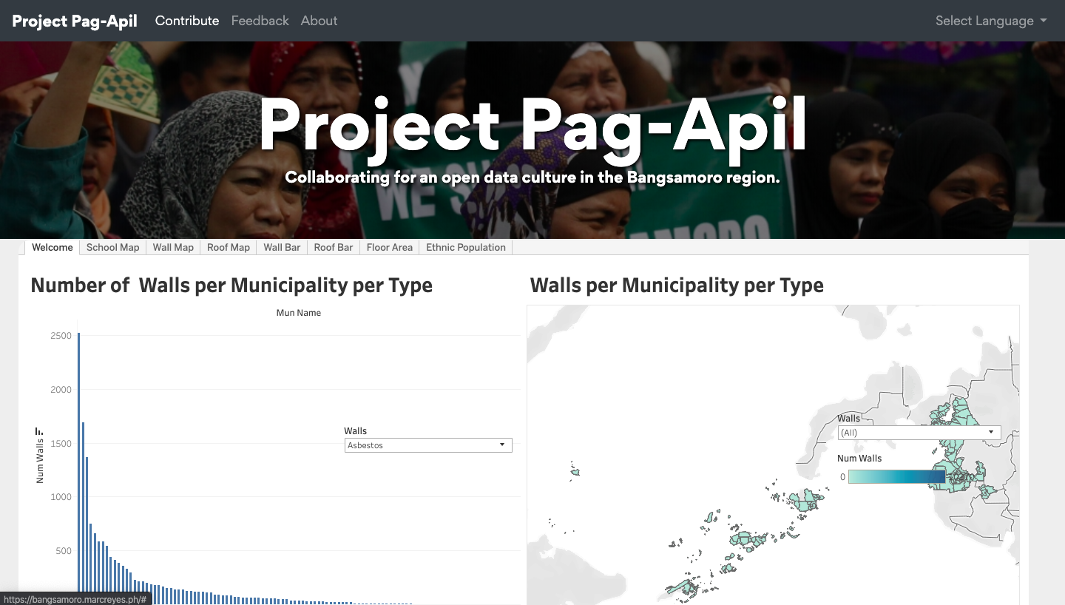
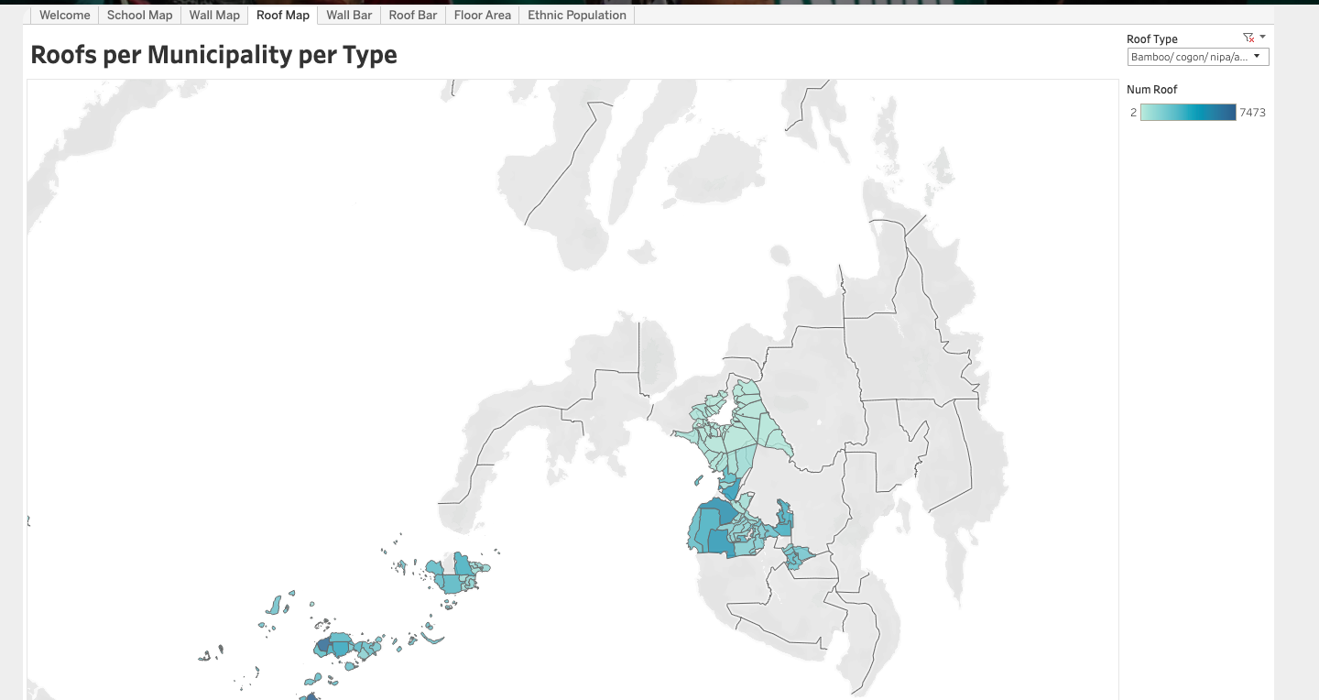
Proof of Concept
https://bangsamoro.marcreyes.ph
https://github.com/PrinceJavier/bangsamoro_eda

Slide 12
Thank you.

Slide 13
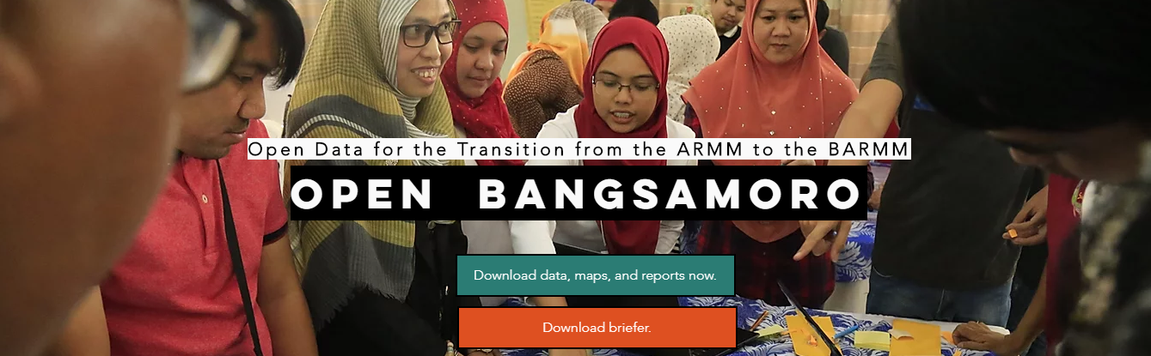
Data Source
We got the data from the Open Bangsamoro site: https://www.openbangsamoro.com/

